Slide 1
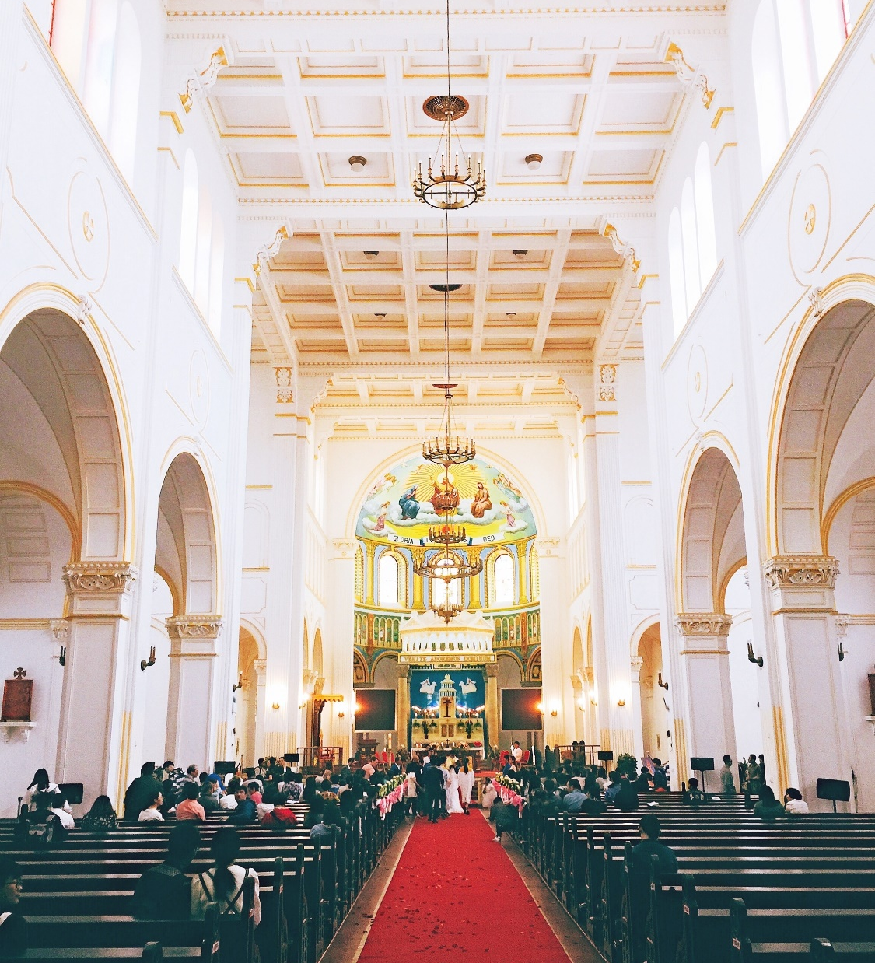
House of Worship

Slide 2
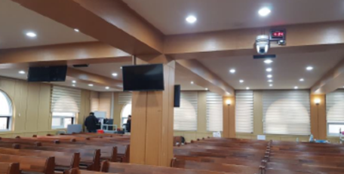
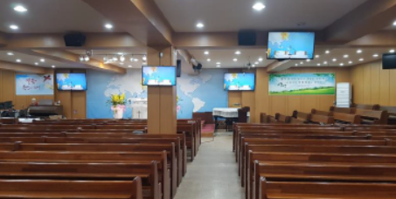
Church in Gyeonggi
Korea
Success Stories
House of Worship
Product: VC-A60S, VS-K20
  PTZ Camera VC-A60S are installed in the main church hall to capture speakers and audience for live production and live streaming.
  The space of the main church hall is considerable ample that the VC-A60S 30x optical zoom is a critical function for capturing desired views, and the primary connection is via optical fiber
  The camera controller VS-KB20 is able to control PTZ through RS232 daisy chain.
“Ministers and church staff are very satisfied with the high image quality, reasonable price, and stability. 30x optical zoom is essential due to space is large.”
Customer Testimonial

Slide 3
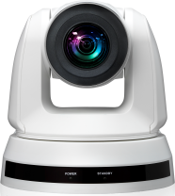
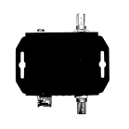

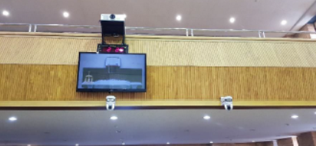
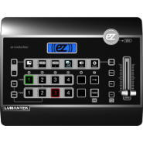
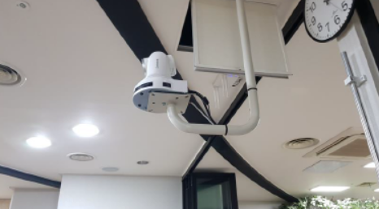

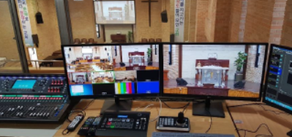
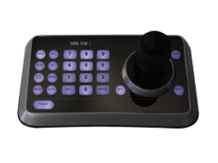

Church in Gyeonggi
Korea
Success Stories
House of Worship
Lumens PTZ Camera
VC-A60S
Product: VC-A60S, VS-K20
SDI
Optical Fiber
Production Switcher
Multi-view
RS232
HDMI
SDI
SDI
Optical Fiber
Audio
Display
RS232
Lumens Camera Controller
KB20
Audio Mixer

